Slide 1
E-Health Medical Expert System
Ama Katseena Yawson, Zafar Toshpulatov, Ali Berrada

Slide 2
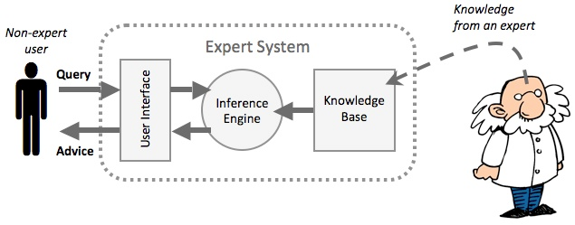
Introduction
An expert system is a computer system that emulates the decision capability of a human expert.
These systems are built by reasoning through bodies of knowledge represented as if-the rules rather than conventional code.
The expert system is divided into 2 phases:
Inference engine – apply rules to the known facts to deduce new facts.
Knowledge base – represents facts and rules

Slide 3
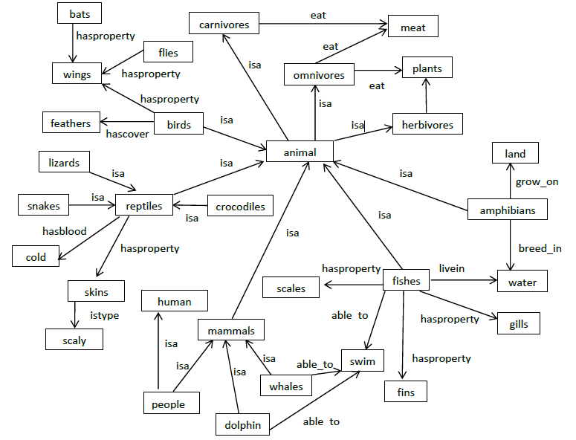
Motivation
Notes:
1. Are bats birds that fly?
2. What type of animal eats plants?
3. What type of animals breed in water but grow on land?
4. Is crocodile a reptile?
5. What are mammals?
6. Which animals fly?
7. Which animals have scales?
8. Which animals are cold-blooded?
9. Can whales swim?
10. What does carnivores eat?
11. Is dolphin a fish?
12. What animals live in water?
13. Are people mammals?
14. Do snakes have scaly skins?
15. What are animals?

Slide 4

Prolog
logic programming language associated with artificial intelligence and computational linguistics
program logic is expressed in terms of relations, represented as facts and rules
computation is initiated by running a query over these relations
Install: “swi-prolog”
http://www.swi-prolog.org/Download.html

Slide 5
Demo
The family tree (diagram) example
Matt
John
Bob
Tim
Bill
Ken
Alex
Ron

